Slide 1
Leading Causes of Death Analysis with Machine Learning
Ali Asghir
Notes:
Aizel

Slide 2
Analysis Importance
Background:
Scientists are constantly trying to find out what factors lead to death whether it be behavioral, environmental, or financial
Inspired by the current trends on health awareness, the improvement of healthy habits, and the increase in life expectancy
Analyze factors that may show correlation to death rates across the US according to data from the CDC, America’s Health Rankings Organization, and the Bureau of Economic Analysis on a 5-year time.
Notes:
Aizel

Slide 3
Analysis Importance
Goal: Analyze the relationship between tobacco use, obesity rates, and per capita income on the number of deaths on a state and national level
Hypothesis: Obesity, tobacco, and income are all positively correlated factors to number of deaths
Variables for Exploration: Tobacco Use %, Obesity %, Per Capita Income, Number of Deaths
Notes:
Aizel

Slide 4
Sources
Leading Causes of Death (for death rates): https://www.cdc.gov/nchs/data-visualization/mortality-leading-causes/index_2.htm
Factors Tobacco Use (tobacco percentage): https://www.americashealthrankings.org/explore/annual/measure/Smoking/
Obesity (obesity rate percentage): https://chronicdata.cdc.gov/Nutrition-Physical-Activity-and-Obesity/Nutrition-Physical-Activity-and-Obesity-Behavioral/hn4x-zwk7/data
Personal Income by state: https://apps.bea.gov/itable/iTable.cfm?ReqID=70&step=1
Notes: Mortality and causal links to behavioral factors: https://www.cdc.gov/mmwr/preview/mmwrhtml/su6304a2.htm#tab3
Notes:
Angelica

Slide 5
Tools Used
Pandas
Matplotlib
Tableau
Scikit-Learn
HTML
CSS
Bootstrap
Notes:
Angelica

Slide 6
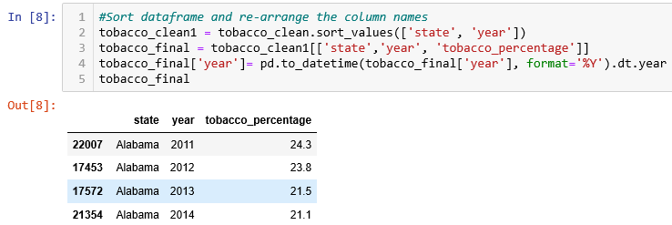
Cleanup
Extract raw data csv files and import to jupyter notebook using pandas to transform the data.
Selected 3 columns from each of the 4 datasets to use in our final dataset for this project.
Notes:
Angelica

Slide 7
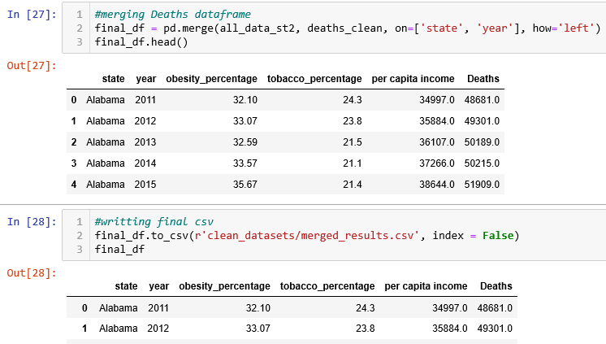
Cleanup
Once the datasets were transformed, we merged all datasets, and exported a merged_results csv file to use it for our analysis and predictions.
Notes:
Angelica

Slide 8
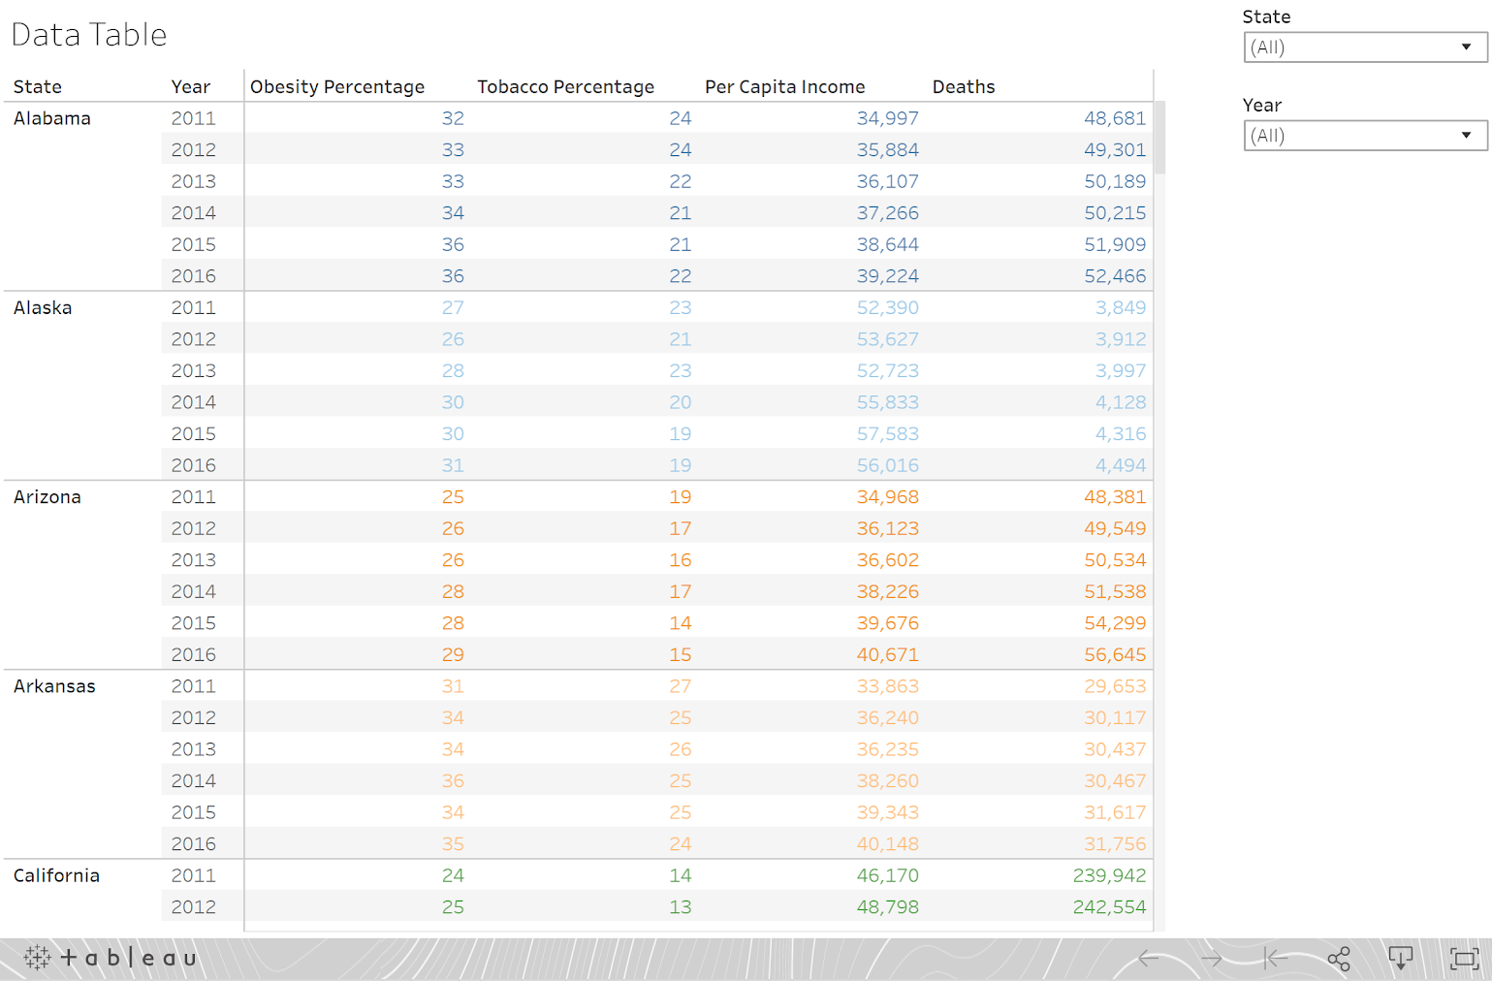
Tableau Data
Used cleanup data ‘merged_results.csv’ to create Tableau Visualization with a drop down filter by state and year.
Notes:
Yafreisi

Slide 9
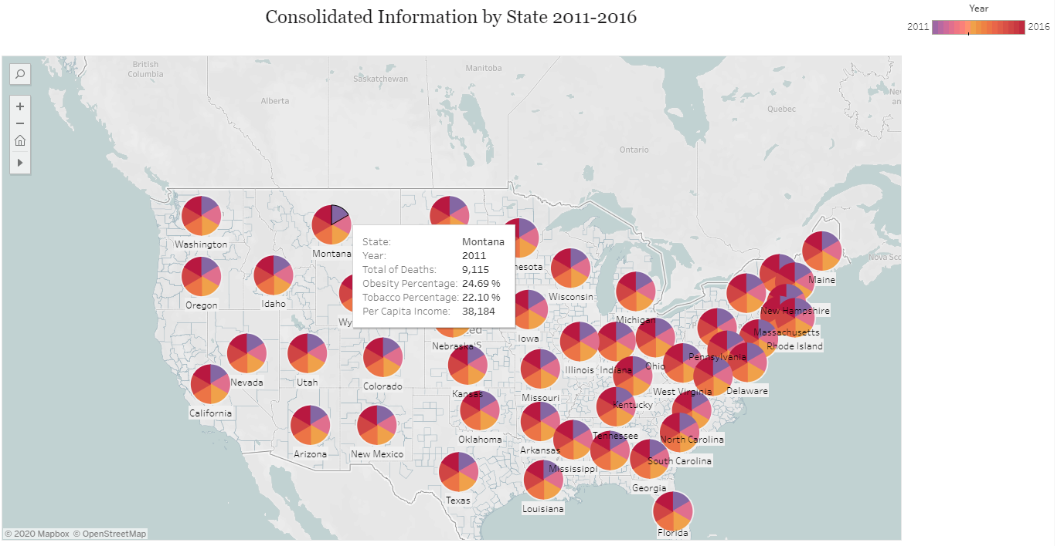
Tableau Visualizations
United States map each state is represented with a pie mark and each slice represents a year of the historical data and all the information (total of deaths, obesity percentage, tobacco consumption percentage and per capita income) of that year is loaded in the tooltip.
Notes:
Yafreisi

Slide 10
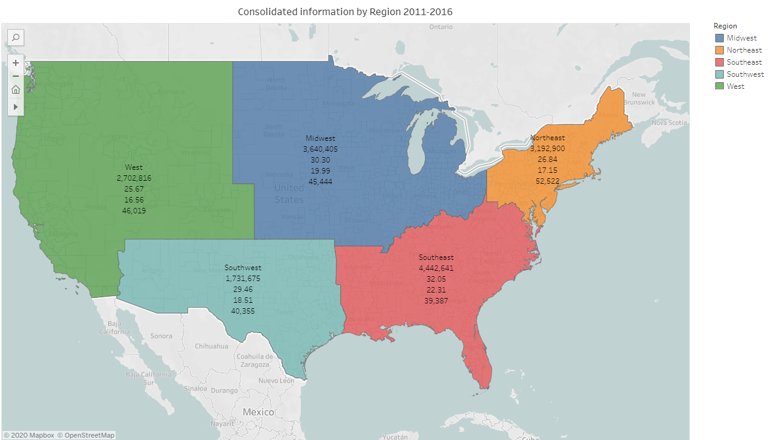
Tableau Visualizations
Notes:
Yafreisi

Slide 11
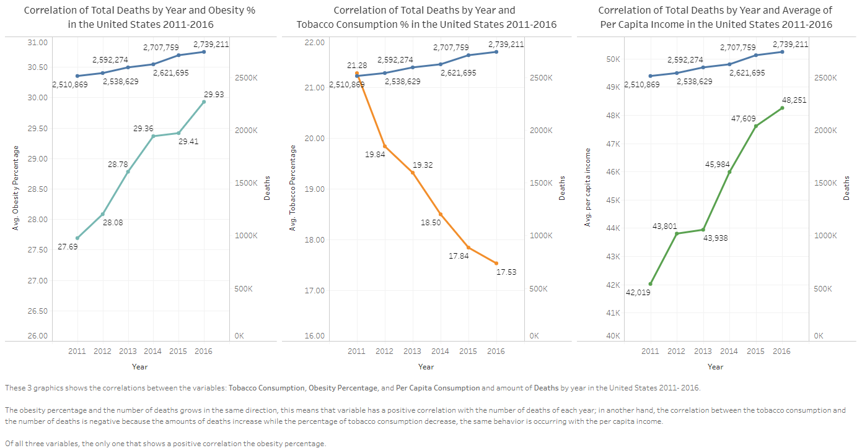
Tableau Visualizations
Notes:
Yafreisi

Slide 12
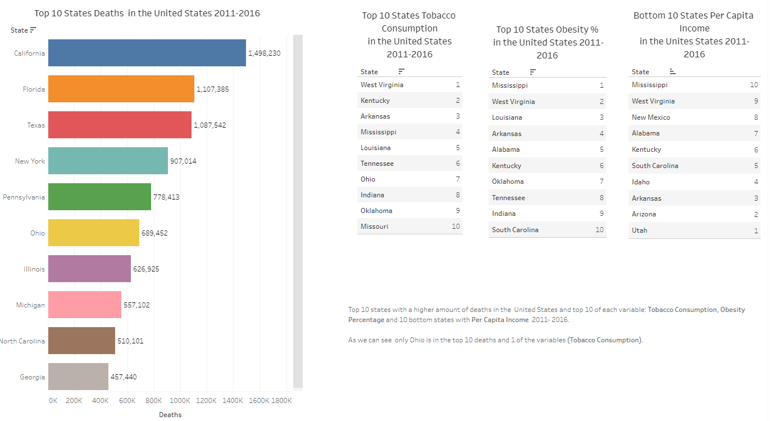
Tableau Visualizations
Notes:
Yafreisi

Slide 13
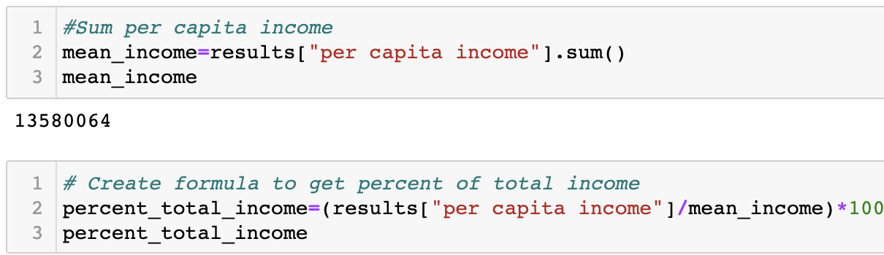
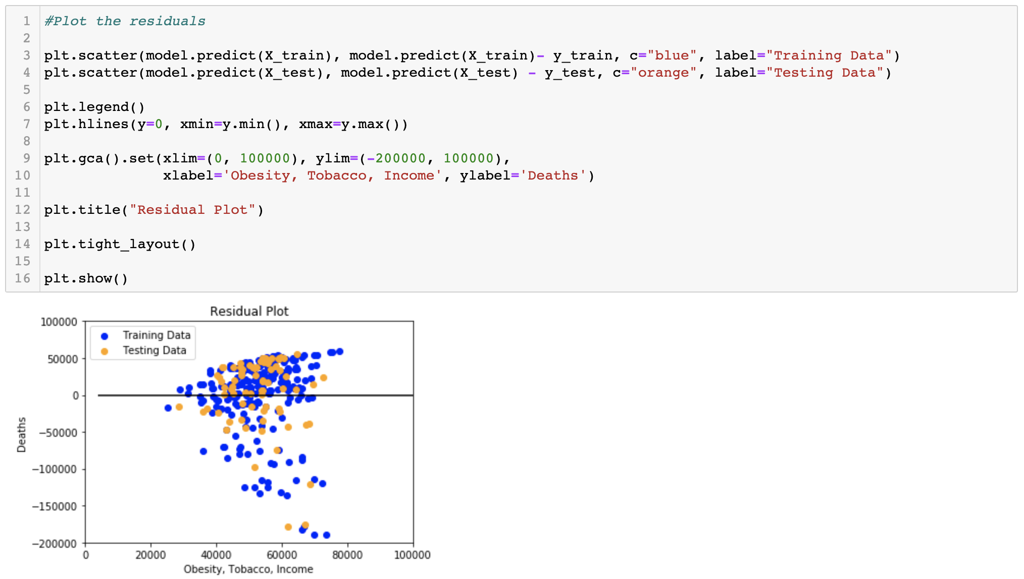
Machine Learning
Cleanup of merged_results for Machine Learning purposes
Changed per capita income from $ to %
Prove: Number of deaths is correlated to obesity rates, tobacco use, and per capita income combined.
Issues: Testing score was higher than the training score and was overfitting the model
Notes:
Zohna

Slide 14
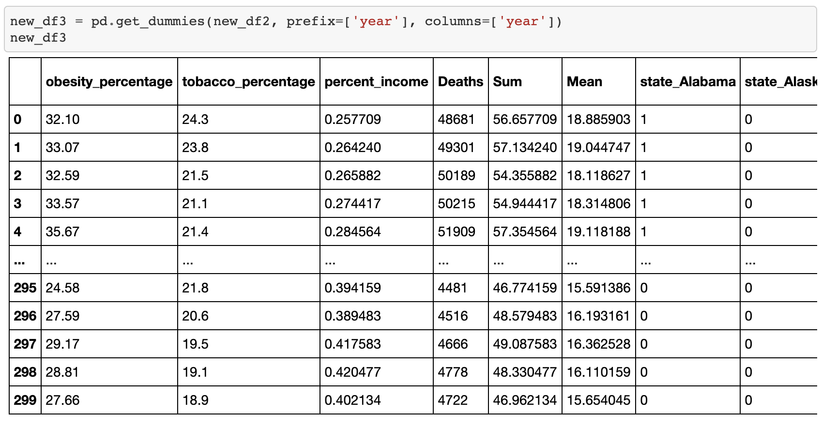
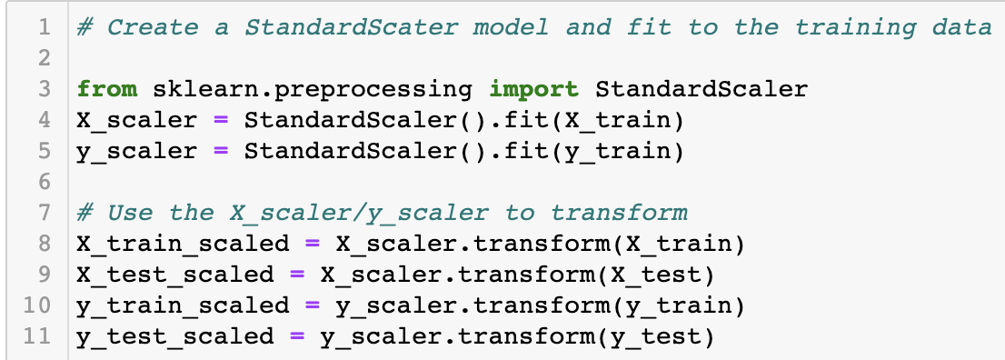
Machine Learning
Revisions
Feature Engineering
Categorical Data
Scaling
Notes:
Zohna

Slide 15
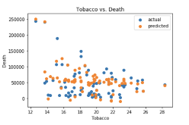
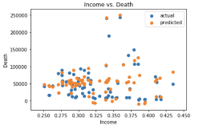
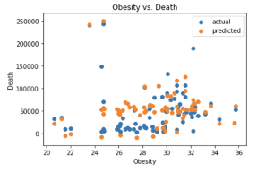
Machine Learning- Individual Regressions
Obesity vs. Death
-Strong correlation
-Outliers
-Weak positive trend
Income vs. Death
-Strong correlation
-No clear trend
Tobacco vs. Death
-Strong correlation
-Weak negative trend
Notes:
Zohna

Slide 16
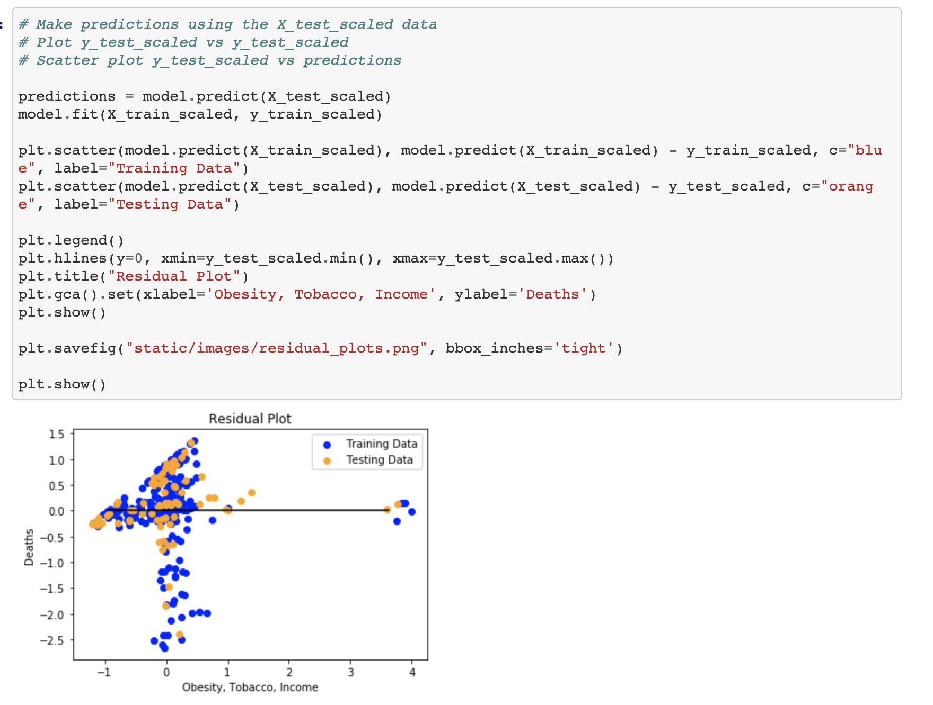
Machine Learning
R2 explains about 56% of the variability of the data around the mean
Outliers skewed results
The mean scored error of .39, close to the desired 0 range
Probabilities of a positive correlation between number of deaths and tobacco use, obesity rates, and per capita income combined are relatively low
Notes:
Zohna

Slide 17
Challenges/What Worked Well
Challenges
Some challenges with machine learning and regression results.
Dataset Issues
Outliers
Residual Plot Issues
What Worked
Data cleaning- simplifying code for ease
Dashboard
Tableau
Feature Engineering for Machine Learning
Notes:
Zohna

Slide 18
Thank you
Notes:
Zohna

